Slide 1
Chances of getting Stroke based on age and BMI correlation
Presented by:
Hozaifa Alam

Slide 2
Content
Introduction
Libraries used in the project
Tasks preformed in project
1. Loading dataset
2. Checking null values
3. Let's look at this distribution by using histogram
Machine Learning Algorithms
1. Logistic Regression
2. Decision Tree Classifier
3. K-Neighbors Classifier
4. Random Forest Classifier
Conclusion

Slide 3
Introduction
Recently I've been fascinated by machine learning and decided to dive more into this world to learn what it is all about. I've taken a course on using the Scikit-learn library through Python and coupled with my previous experience (pandas, matplotlib, numpy, & seaborn), I wanted to try and tackle a ML project. (I've also upped my markdown game from previous notebooks, which I want to showcase a bit as well.)
The project I'm going to do in this notebook is to predict whether or not a patient had a stroke based on a number of medical and personal attributes. The intent is to use this ml model to predict the likelihood of a stroke in future patients. This will be a classification model as we're trying to predict whether a patient falls into the category of "Stroke" or "No Stroke". So without further ado, let's get started!

Slide 4

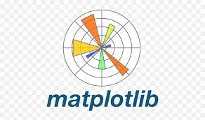

Libraries Used in the project
Pandas
NumPy
Matplotlib
Statistics
Scikit-learn

Slide 5
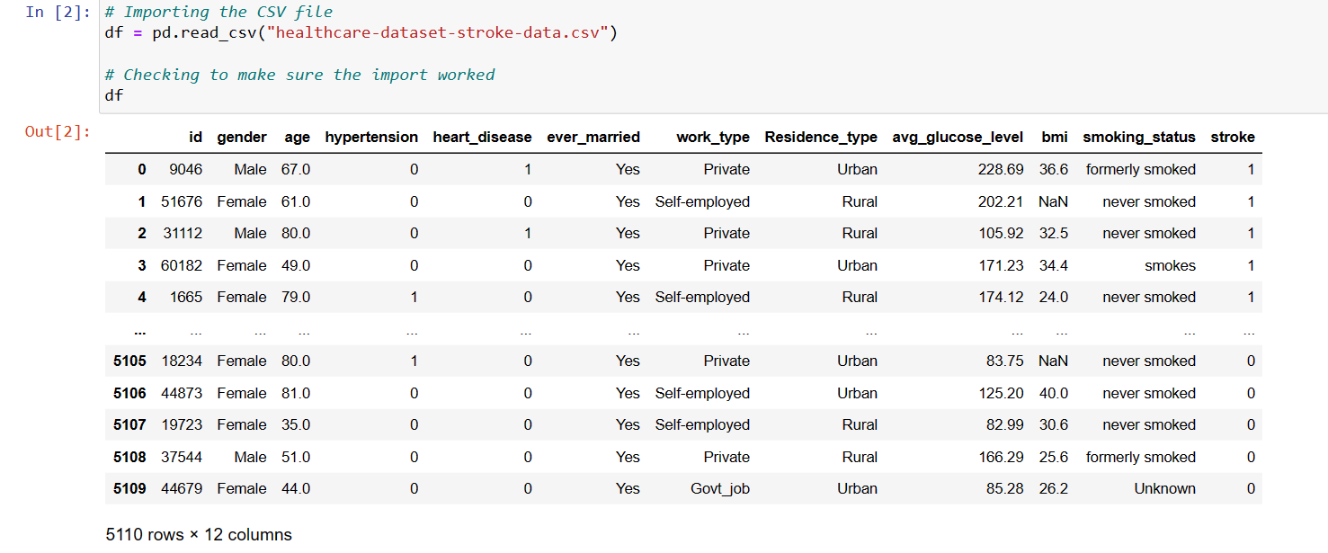
Loading dataset

Slide 6
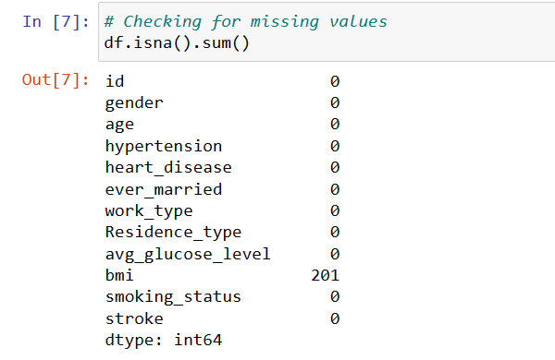
Checking missing values

Slide 7
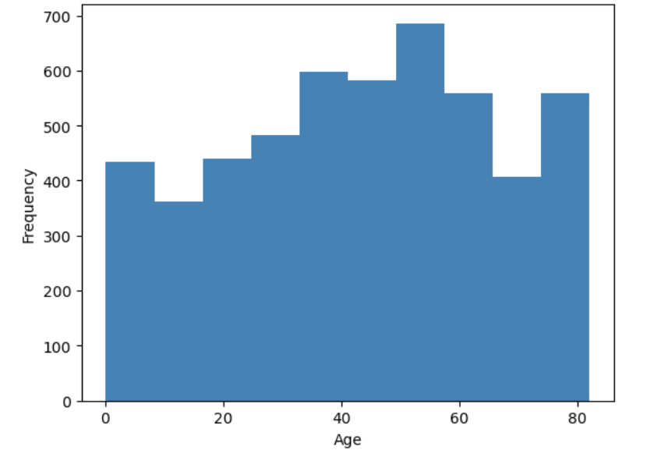
Let's look at this distribution by using histogram

Slide 8
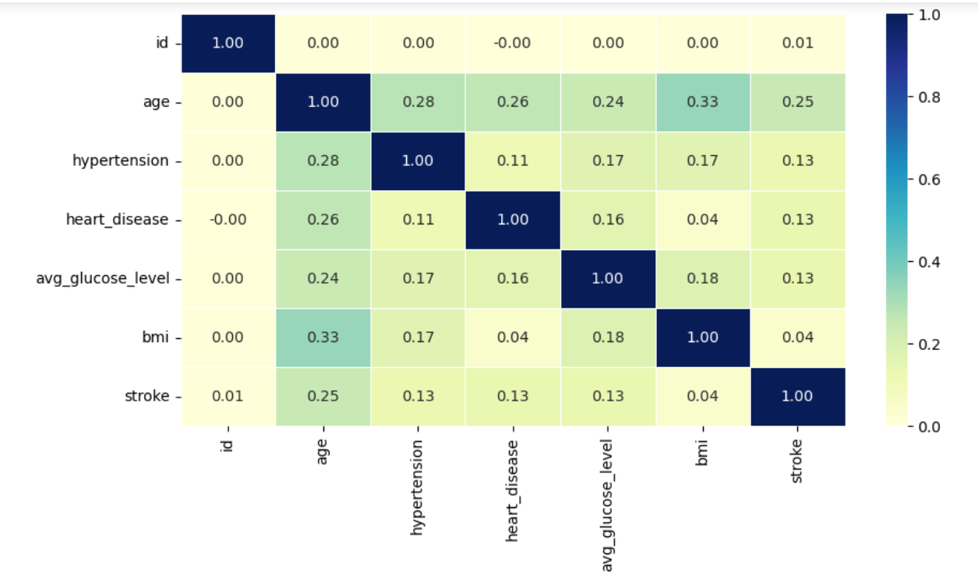
Finding correlation between variables

Slide 9
Machine Learning Algorithm
Logistic Regression Result
Decision Tree Result
K- Neighbours Classifier Result
Random Forest Classifier Result

Slide 10
Conclusion
In this demonstration of the case study, we have gained an understanding of how to apply various data pre-processing steps and different classification algorithms.

Slide 11


